Slide 1


Slide 2
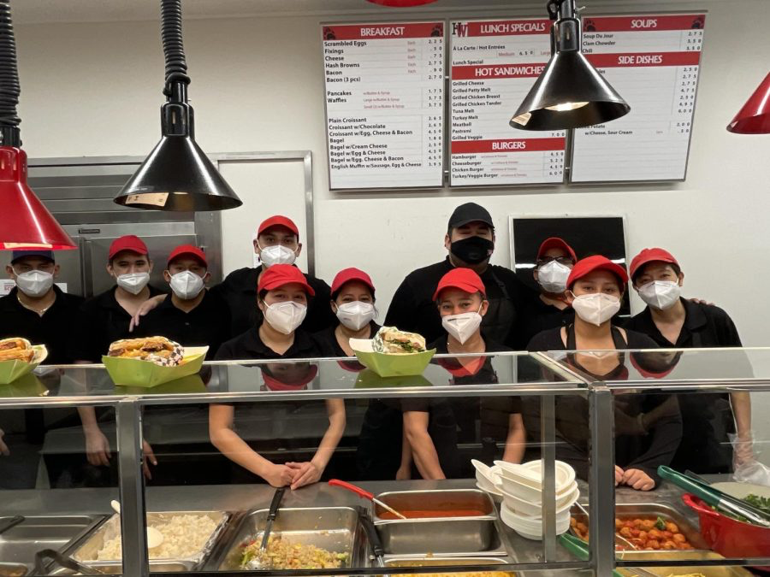

Slide 4

fryHW

Slide 5
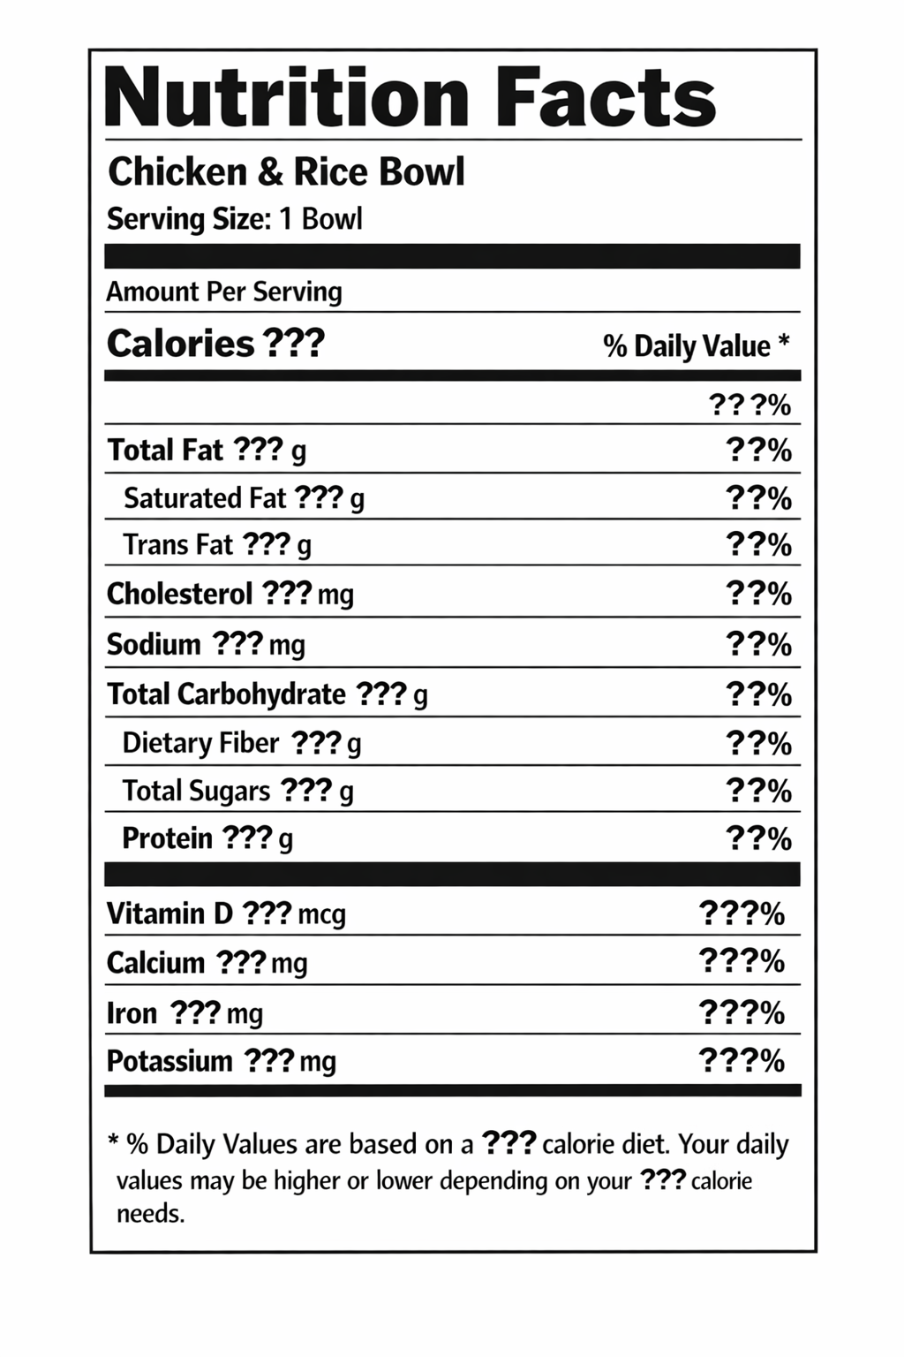
Harvard-Westlake Calorie Counter
Web application
Nutrition facts for all meals

Slide 6
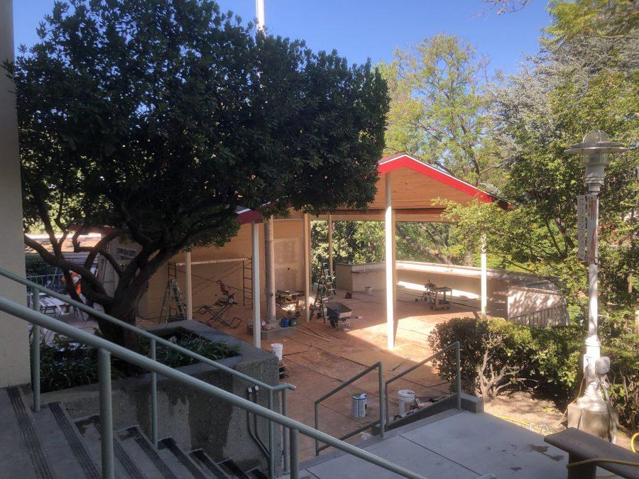
View Lunch Menu for Every Day
Useful for athletes & general diet planning

Slide 7
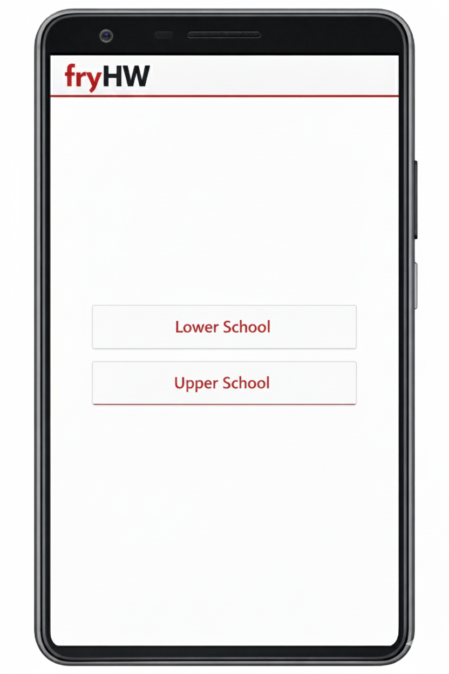
Lower & Upper School

Slide 8
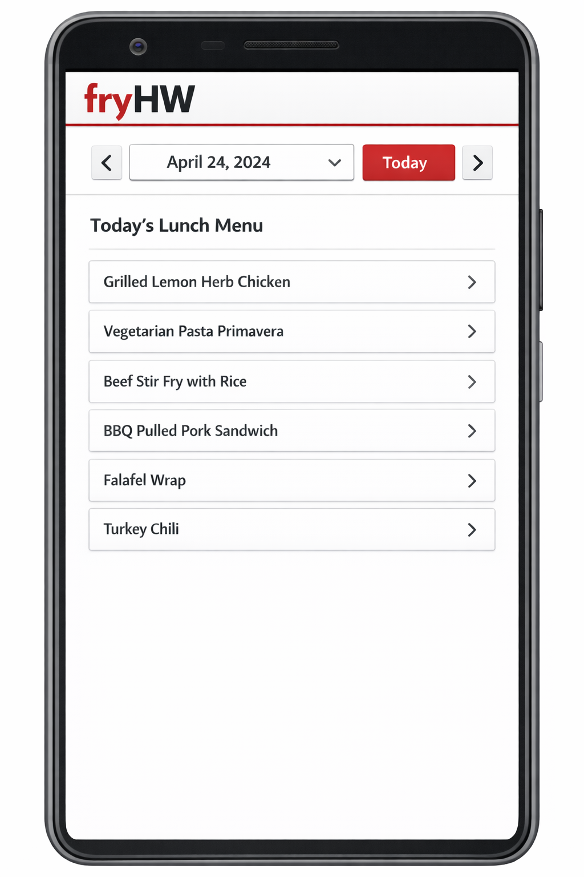
Select another campus

Slide 9
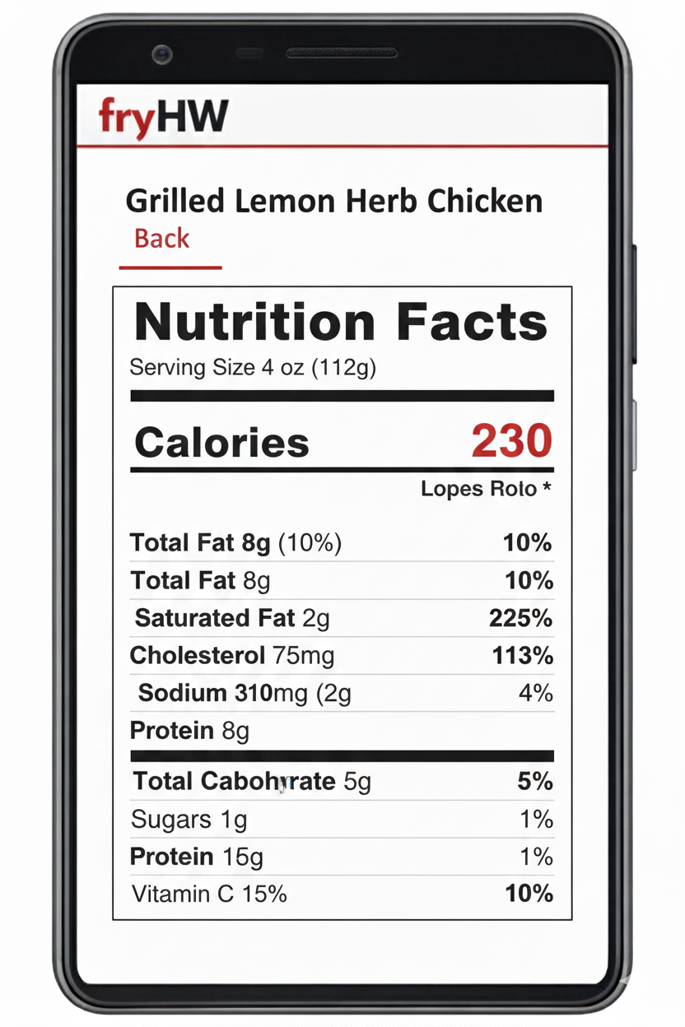

Slide 11
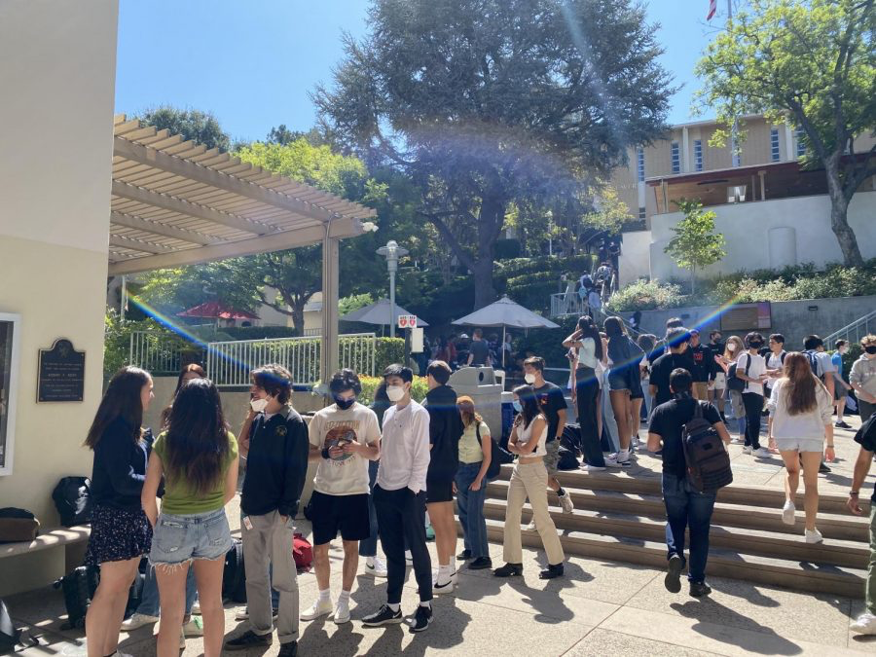
Target Audience
Anyone who regularly eats at the HW cafeteria

Slide 12
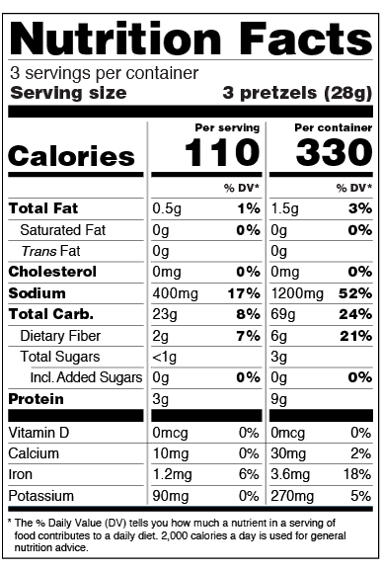
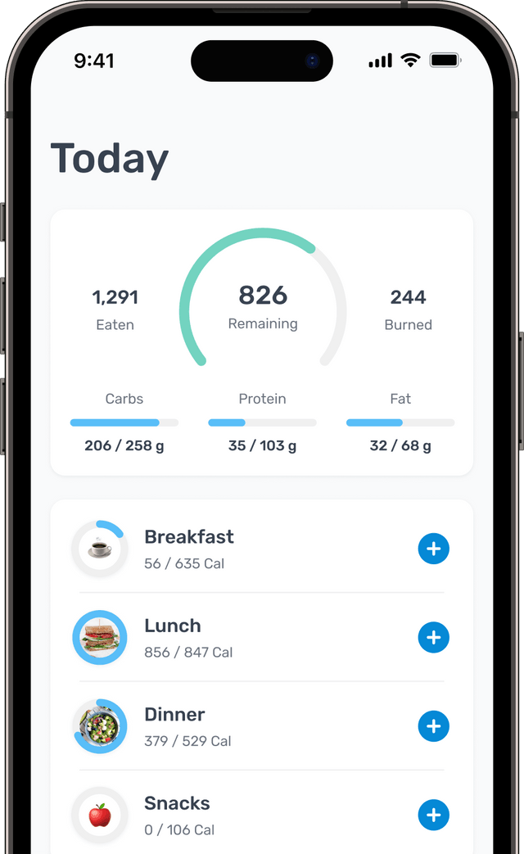
Capabilities
Not a full calorie counter
Easy, accessible way of viewing nutrition facts for Harvard-Westlake meals

Slide 13
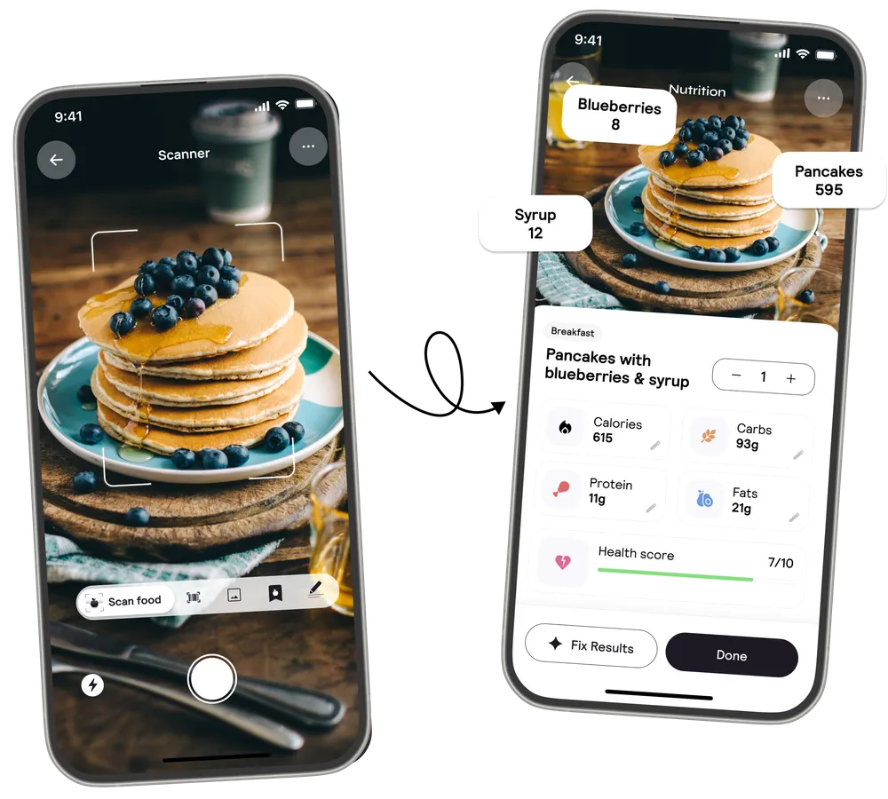
Existing Apps
Nutrition facts for the HW cafeteria specifically are not easily accessible
There are AI-powered calorie-counting apps, but they have limited accuracy and do not know past & future HW lunch menus

